Slide 1
Radius Worksheets
Agility and Innovation
Build Better Networks,Together

Slide 2
How will you embrace agility?
How is your network currently bureaucratic, and how can it be made more agile?
Who are your customers (or end users)?
How do you get value from them?
How do you give value to them?
How could your network better embrace the agility of small teams?
How does your network link into the broader organisational network, and how can you make better connections?

Slide 3
How will you create space for innovation?
How will you ensure a diversity of input to generate your proposals?
How will you offer “prototype” ideas and get feedback?
How will you set the scene with stakeholders (e.g. your network, wider organisation, executives, etc) to increase the odds of adoption?
How can you “nudge” behaviour change?
How will you account for and challenge bias?

Slide 4
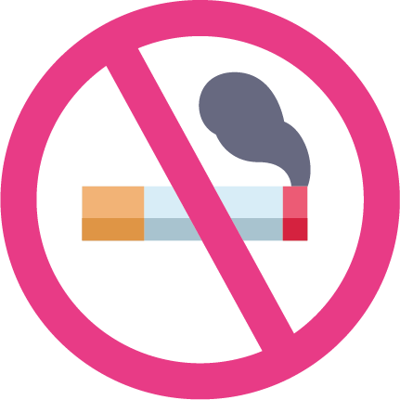
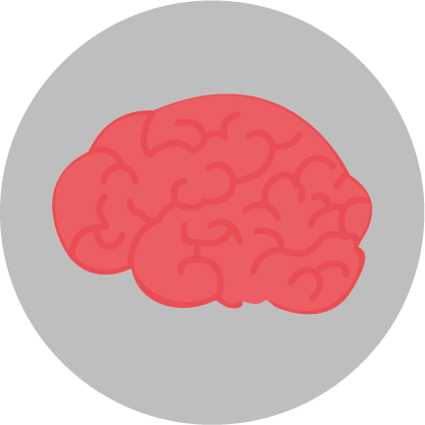
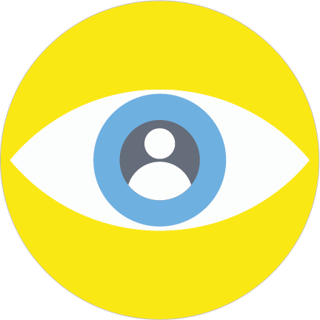
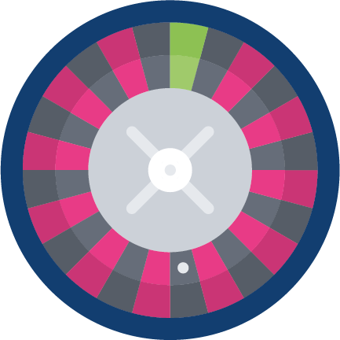
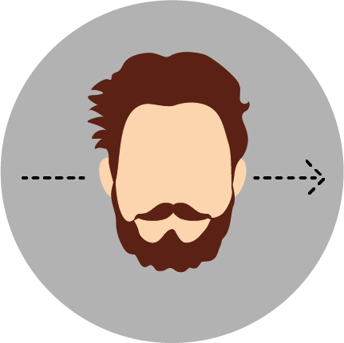
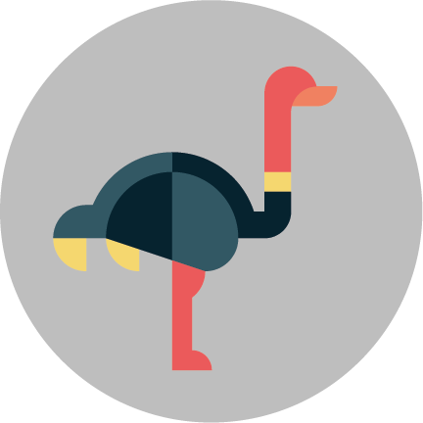
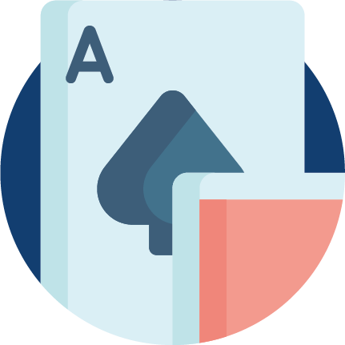
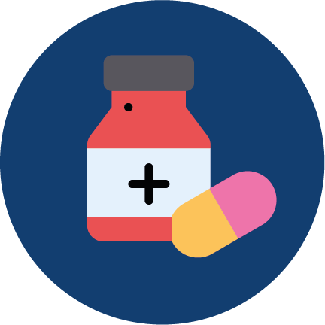
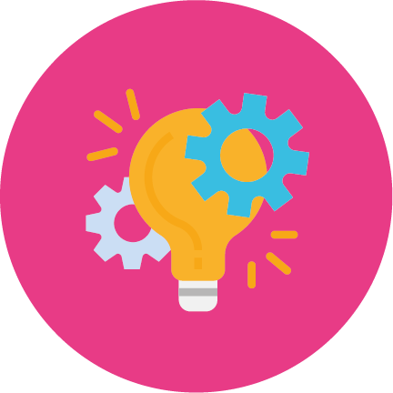
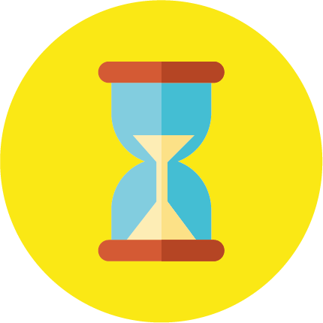
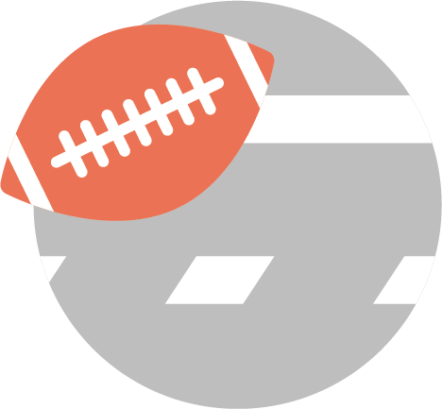
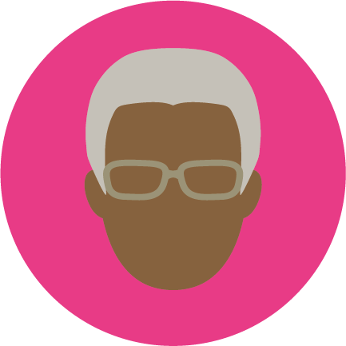
Bias crib sheet
1. Anchoring bias
People are over-reliant on the first piece of information they hear. In a salary negotiation whoever makes the first offer establishes a range of reasonable possibilities in each person’s mind
2. Availability heuristic
People overestimate the importance of information that is available to them. A person might argue that smoking is not unhealthy because they know someone who lived to 100 and smoked 3 packs a day
3. Bandwagon effect
The probability of one person adopting a belief increases based on the number of people who hold that belief. This is a powerful form of groupthink and is reason why meetings are often unproductive
4. Blind-spot bias
Failing to recognise your own cognitive biases is a bias in itself. People notice cognitive and motivational biases much more in others than in themselves
5. Choice-supportive bias
When you choose something, you tend to feel positive about it, even if that choice has flaws. Like how you think your dog is awesome - even though it bites people once in a while
6. Clustering illusion
This is the tendency to see patterns in random events. It is key to various gambling fallacies, like the idea that red is more or less likely to turn up on a roulette table after a string of reds
7. Confirmation bias
We tend to listen only to information that confirms our preconceptions - one of the many reasons seeing things from multiple perspectives is important
8. Conservatism bias
Where people favour prior evidence or information that has emerged. People were slow to accept that the Earth was round because they maintained their earlier understanding that the planet was flat
9. Information bias
The tendency to seek information when it does not affect action. More information is not always better. Like insisting the case for D&I be made over and over again even though it’s already been done
10. Ostrich effect
The decision to ignore dangerous or negative information by ‘burying’ one’s head in the sand, like an ostrich. Research suggests that investors check the value of their holdings and significantly less often during bad markets
11. Outcome bias
Judging a decision based on the outcome - rather than how exactly the decision was made in the moment. Just because you won a lot in Vegas doesn’t mean gambling your money was a smart decision
12. Overconfidence
Some of us are too confident about our abilities, and this causes us to take greater risks in our daily lives. Experts are more prone to this bias than laypeople, since they are more convinced that they are right
13. Placebo effect
When simply believing that something will have a certain effect on you causes it to have that effect. In medicine, people given fake pills often experience the same psychological effects as people given the real thing
14. Pro-innovation bias
When a proponent of an innovation tends to overvalue its usefulness and undervalue its limitations. This is often seen in tech startup valuations.
15. Recency
The tendency to weigh the latest information more heavily than older data. Investors often think the market will always look the way it looks today and make unwise decisions
16. Salience
Our tendency to focus on the most easily recognisable features of a person or concept. When you think about dying, you might worry about being mauled by a lion, as opposed to what is statistically more likely, like dying in a car accident
17. Selective perception
Allowing our expectations to influence how we perceive the world. An experiment involving a football game between students from two universities showed that one team saw the opposing team commit more infractions
18. Stereotyping
Expecting a group or person to have certain qualities without having real information about the person. It allows us to quickly identify strangers as friends or enemies, but people overuse and abuse it
19. Survivorship bias
An error that comes from focusing only on surviving examples, causing us to misjudge a situation. For example we might see social mobility as easy because we watch so many talks from “people who made it”
20. Zero risk bias
Sociologists have found that we love certainty - even if it’s counterproductive. Eliminating risk entirely means there is no chance of harm being caused

